Slide 1
FAST TRACK
Samantha Baggett
Auburn University/Auburn Montgomery

Slide 2
ARE YOUR WAITING ROOMS FULL???
Notes:
Overcrowding is one of the most serious issues con- fronting EDs today. As a consequence, many patients experience significant waiting times prior to accessing medical care.

Slide 3
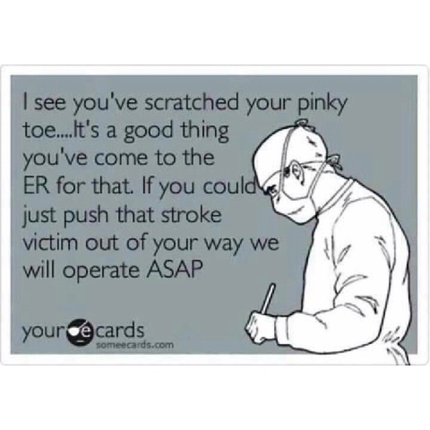
ARE SOME PATIENTS YOU SEE
NON-EMERGENT???
Notes:
Emergency department fast track systems “stream” patients with non-urgent complaints to treatment in a dedicated area with a goal to decrease waiting times and emergency department length of stays, reduce overcrowding and increase patient and staff satisfaction.

Slide 4
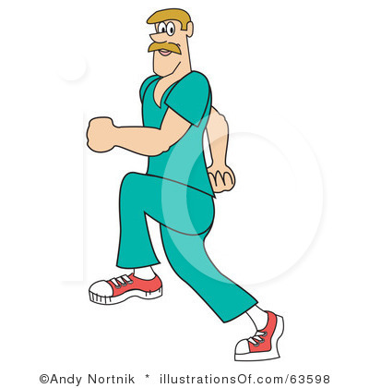
FAST TRACK BENEFITS!!
SHORTER WAIT TIMES! (NO MORE CROWDING)
DECREASED LENGTH OF STAY
FINANCIAL SAVINGS
INCREASED PATIENT SATISFACTION
DECREASED LEFT-WITHOUT-BEING-SEENS
Notes:
To address this growing problem, and in the context of ever-increasing patient attendances, many EDs have established separate ‘fast track’ areas to care for patients with less urgent medical problems. Fast track has been associated with documented improvements in patient waiting times, length of stay and did-not-waits in both adult and mixed adult and pediatric Eds.

Slide 5
ER FAST TRACK
FRIDAY – MONDAY 11am-11pm
NURSE PRACTITIONER
One REGISTERED NURSE
One MULTI-SKILLED TECHNICIAN
Notes:
. Fast track systems are designed to improve emergency department capacity during peak demand. All fast track models reviewed had similar aims but variability as each model was designed to meet local needs. This concept of variability to meet the present population’s populations needs will be a main concern for those fast track leaders. All fast track models were designed to manage single system, non-urgent, uncomplicated complaints with dedicated nursing staff (Considine, Kropman, Kelly & Winter, 2008).

Slide 6
TRIAGE!
CHIEF COMPLAINT
INITIAL “QUICK” ASSESSMENT
VITAL SIGNS
Notes:
The triage nurse will have the responsibility of utilizing a quick assessment, obtaining vital signs and evaluating the patient chief complaint. Common patient chief complaints that qualify for Fast Track consist of the following but are not limited to: minor lacerations, abscesses without systemic complaints, extremity pain, back pain, headache, sinus congestions, sore throat, dysuria and flu-like symptoms. If the patient qualifies for “Fast Track” then the patient will be escorted to a Fast Track bed by the multi-skilled technician.

Slide 7
TEAMWORK & TIME!!
Notes:
The nurse will perform an initial assessment. Both the vital signs and assessment will be reported to the nurse practitioner. The nurse practitioner then will perform his/her own assessment prior to ordering diagnostic or treatments for the patient. The nurse and technician will carry out the practitioner’s orders within their scope of practice. The multidisciplinary team will work together throughout the patients stay to monitor patient’s response to treatment and discuss proper education for the patient prior to discharge. The overall goal will be to supply the patient with quality care within ninety minutes.

Slide 8
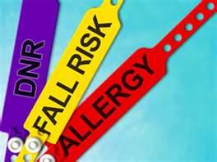
NO MATTER WHAT…….
Notes:
Providers’ decisions and actions affect the patient’s overall health. The implementation of fast track will help to improve provider accessibility and meet patients’ needs using evidence based practice and quality care in the shortest amount of time. Patient’s safety should always be of first priority.

Slide 9
Significant Issues
A MEDICAL HOME!
Notes:
Leaders must focus on professional qualities that build the moral of their facilities constituents. An emergency department fast track can provide quality care in a timely manner to many individuals and give them a “healthcare home”.
A key feature of the new healthcare changes is a push for all patients to have a medical home. This move will force healthcare leaders to engage in research for the best evidence based quality care practices to implement in their facilities. The four pillars of primary care are first-contact care, longitudinal care, comprehensive care and coordination of care. All of these areas should be the sole responsibility of practitioners to lead their patients into trusting relationships so that they will choose to return and be confident in the care they receive (Bodenheimer, 2008).

Slide 10
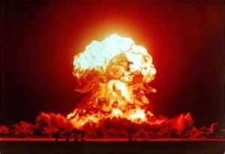
SMALL INITIATIVES…. BIG IMPACT!!!
Notes:
The Community Care of North Carolina, which is now a gold standard of healthcare, began as a small project in 1988 and was not launched in a large capacity until 1998. Had it not been for the leadership, the small pilot of 1988 could have died. Project leaders must recognize and expect large pilots of improvement take time (Bodenheimer, 2008). This project will be a complex change involving many members of an interdisciplinary team. Leaders must be ready to motivate the team members and encourage a positive outlook of impactful quality improvement for the future. Nurses and healthcare leaders throughout the world need to know how to maneuver through whatever political system is operating in their countries. However, it is the responsibility of nurses to seek leadership positions in government and quasi-government institutions (Milstead,).

Slide 11
WORKING TOGETHER!!
EVERYONE
WILL BE
TRAINED!
Notes:
The Iowa Model uses a multidisciplinary team approach. The team is formed to develop, implement and evaluate practice change. This team may include staff nurses, unit managers, emergency room staff and advanced practices nurses, all of which are present and make up the emergency room fast track. Initially the team selects, reviews, critiques and synthesizes available research evidence. The team then tries the practice change to determine the feasibility and effectiveness of the evidence based practice change in the clinical area (Melnyk & Fineout-Overholt, 2011, p.252). Within this project, all members of the emergency room staff will be trained to perform well within their scope of practice in the fast track area.

Slide 12
ETHICAL CONSIDERATIONS
AUTONOMY/INFORMED CONSENT
NONMALEFICENCE
BENEFICENCE
JUSTICE
Notes:
As fast tracks become more common in the United States, the need for providers to have a solid foundation in the ethics of delivering necessary health care is growing. Hospital administrators and policy makers must establish a system of health delivery that is ethical for all patient populations (Bergman, 2012). To be in line with the principle of autonomy and informed consent, the care provided in an emergency department fast track should be comparable and equivalent to that provided by physicians in the emergency department and all patients must be told that they are being triaged to the fast track area and will be seen by a nurse practitioner (Bergman. 2012).
Nonmaleficence requires that fast track staff not create an unnecessary harm and follow standard of care. Fast tracks should improve the efficiency of the entire emergency department as a whole and should allow more patients to be seen by the appropriate level of providers while not lowering the standard of care to those patients (Bergman, 2012).
Beneficence requires that fast track staff promote good and act in the best interest of the patient. Fast track policies should not restrict the use of laboratory testing when it would otherwise be indicated and should not restrict the use of IV fluids or other medical interventions when they could benefit the patient (Bergman, 2012).
Justice ensures quality of care to all patients. All patients of a certain triage category should have equal chances of being placed in the regular emergency room and nonmedical criteria, such as pay, should not influence being placed in the fast track area (Bergman, 2012).
Fast track areas in emergency departments present a unique situation in which ethical dilemmas can occur by attempting to fix an overcrowded or overwhelmed emergency room. As long as safeguards are in place along with monitoring the use of fast tracks is ethically permissible. Enforcing proper hospital policies and reviewing charts of pervious patients are tasks that can ensure every patient placed in the fast track received all appropriate and indicated medical care (Bergman, 2012).

Slide 13
MOCK FAST TRACK…..
PRACTICE MAKES PERFECT!!!
Notes:
NOW WE WILL GO THROUGH A MOCK FAST TRACK PATIENT SCENARIO…..

Slide 14
REFERENCES
Bergman, B., (2012). Fast-track area in the emergency department: are they ethical?
Journal of American Academy of Physicians Assistants, 25(10), 57-58.
Considine, J., Kroman, M., Kelly, E., Winter, C. (2008). Emergency Medicine Journal,
25, 815–819. doi:10.1136/emj.2008.057919
Handley, A. (2011). Fast-track to efficiency. Nursing Standard, 25(20), 18-19.
Kritsonis, A. (2004-2005) A comparison of change theories. International Journal of
Scholarly Academic Intellectual Diversity, 8(1).
Kwa, P., & Blake, D. (2008). Fast track: Has it changed patient care in the emergency
department?. Emergency Medicine Australasia, 20(1), 10-15. doi:10.1111/j.1742-6723.2007.01021.x
Porter-O’Grady, T. & Malloch, K. (2011). Quantum leadership: Advancing innovation,
transforming health care. (3rd ed.) Sudbury, MA: Jones & Bartlett Learning.
Ieraci, S., Digiusto, E., Sonntag, P., Dann, L., & Fox, D. (2008). Streaming by case
complexity: Evaluation of a model for emergency department Fast Track. Emergency Medicine Australasia, 20(3), 241-249. doi:10.1111/j.1742-6723.2008.01087.x
Waterman, H. (2011). Principles of ‘servant leadership’ and how they enhance practice.
Nursing Management-UK, 17(9), 24-26.
Notes:
EACH STAFF MEMBER MAY PICK UP A COPY OF PAPER THAT GOES INTO MORE DETAIL OF INSTITUTIONAL ASSESSMENT AND IMPLEMENTATION PLAN.

